Slide 1

High Impact Skills Development Program
in Artificial Intelligence, Data Science, and Blockchain
Module 1: AI Fundamentals
Lecture 2: Introduction to Deep Learning
Faculty Head: Dr. Khuram Shahzad
Thanks to Dr Adnan Ul-Hasan
Team Lead, Deep Learning Lab, NCAI

Slide 2
What is Machine Learning?

Slide 3
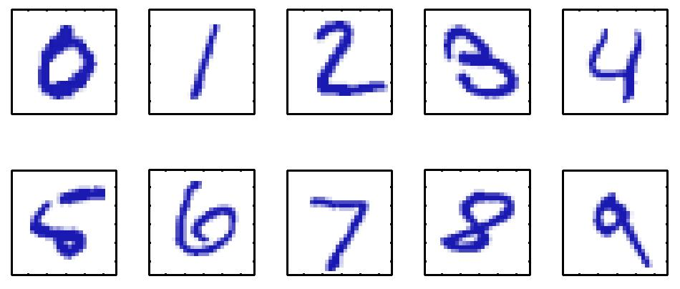
Example
Handwritten Digit Recognition

Slide 4
Goal of Machine Learning
Consider a 28 x 28 pixel image
Represented by a 784-dimensional vector x
Goal: build a machine that takes the vector x as input and produces the identity of digit 0,…,9 as the output
Tom Mitchel’s definition of Machine Learning: A computer program is said to learn from experience E with respect to some class of tasks T and performance measure P, if its performance at tasks in T, as measured by P, improves with experience E.

Slide 5
Important Terminology
Training data
Data samples
Target vectors
Learning / Training
Machine takes training data and automatically learns mapping from data samples to target vectors
Test data
Target vectors are concealed from the machine
Machine predicts the target vectors based on previously learned model
Accuracy can be evaluated by comparing the predicted vectors to the actual vectors

Slide 6
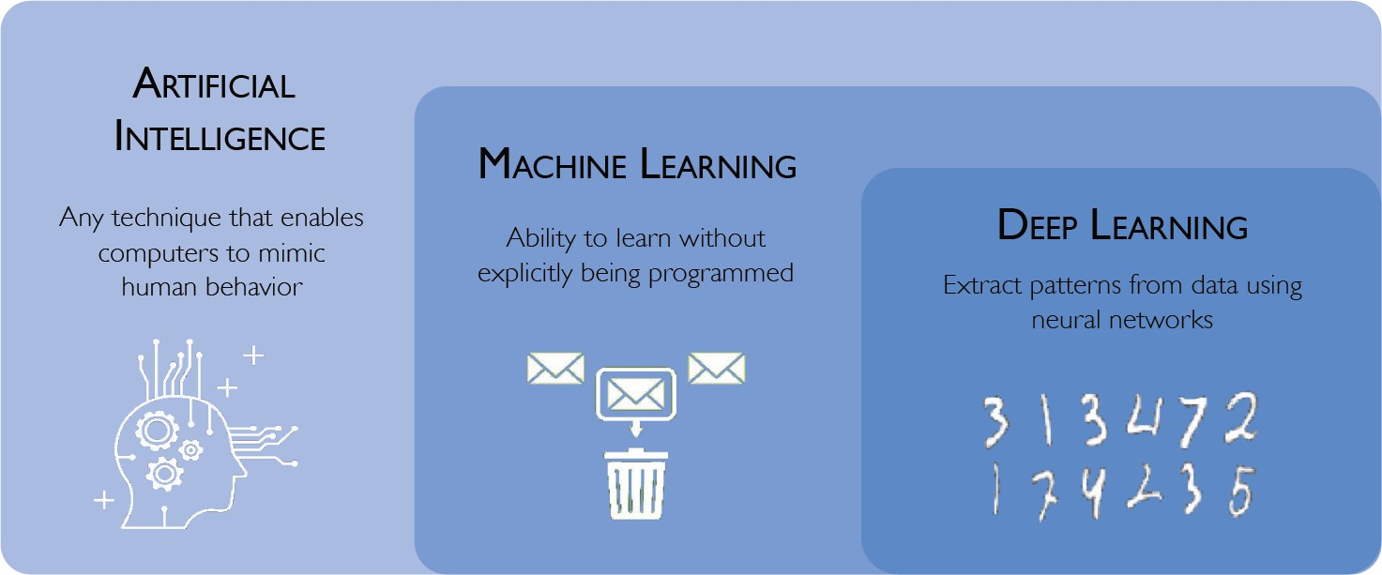
What is AI, Machine (Deep) Learning

Slide 7
What is AI, Machine (Deep) Learning

Slide 8
What is AI, Machine (Deep) Learning

Slide 9
Types of Machine Learning Problems

Slide 10
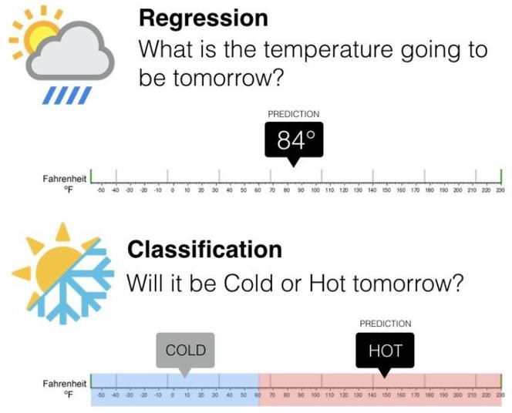
Types of Machine Learning Problems
Supervised learning
Regression
Classification
Unsupervised learning
Clustering
Density estimation

Slide 11
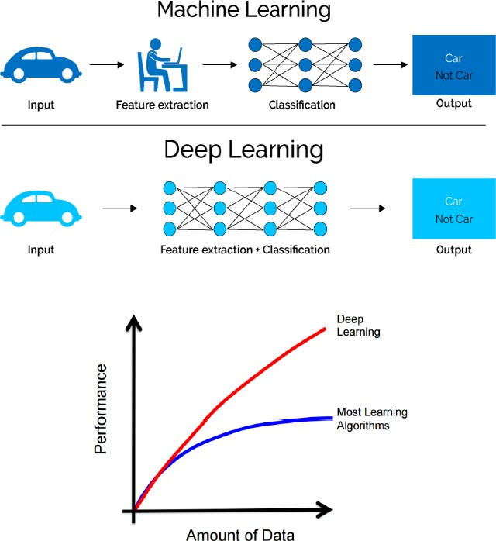
Machine Learning vs Deep Learning

Slide 12
The “deep” in Deep Learning
Stands for this idea of successive layers of representations
How many layers contribute to a model of the data is called the depth of the model
Modern deep learning often involves tens or even hundreds of successive layers of representations — and they’re all learned automatically from exposure to training data
Meanwhile, other approaches to machine learning tend to focus on learning only one or two layers of representations of the data; hence, they’re sometimes called shallow learning

Slide 13
Achievements
Near-human-level image classification, speech recognition, handwriting transcription, autonomous driving
Improved machine translation, text-to-speech conversion, search results on the web, ad targeting (Google, Baidu, and Bing)
Digital assistants such as Google Now and Amazon Alexa
Ability to answer natural-language questions
Superhuman Go playing
Artificial Arts and game playing

Slide 14
Memory Lane
1943
Neural Networks
1957–1962
Perceptrons
1970–1986
Backpropagation, RBM, RNN
1979-98
CNN, LSTM, MNIST
2006
Deep Learning, DBN
2009
ImageNet, AlexNet
2014
GANs
2016-17
AlphaGo, AlphaZero
2017-19
Transformers, GPT
2022
GPT 3.5
2021
DALL-E
Deep Learning Boom

Slide 15
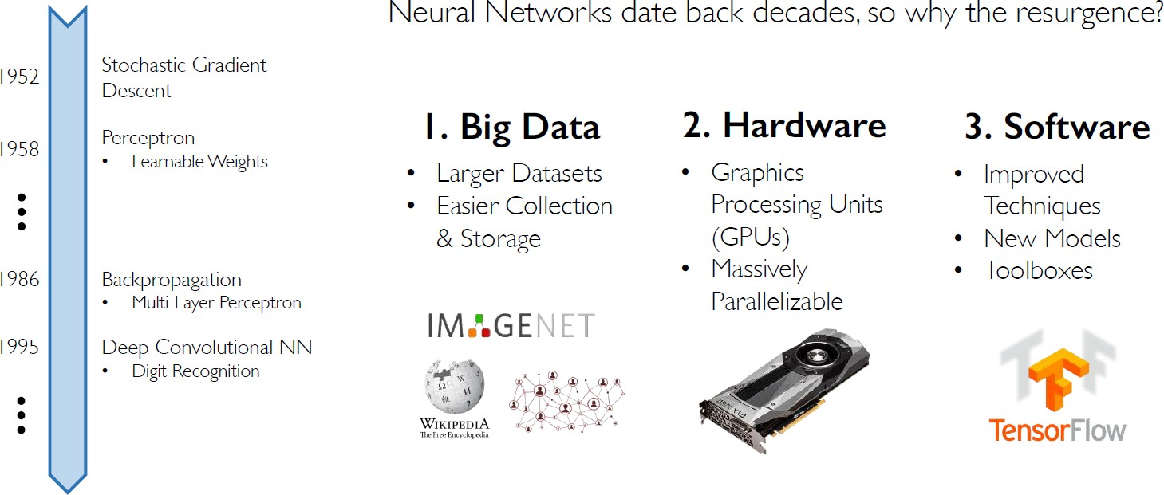
Why Deep Learning is so successful?

Slide 16
Typical Cycle Design
Data Collection
Feature Choice
Model Training
Model Selection
Performance Evaluation

Slide 17
Typical Cycle Design
Data Collection
Feature Choice
Model Training
Model Selection
Performance Evaluation
Training Set: Example used for learning | Target Value is known
Validation Set: Architecture Tuning and Error Estimation
Test Set: Assess the performance | Never seen before

Slide 18
Typical Cycle Design
Data Collection
Feature Choice
Model Training
Model Selection
Performance Evaluation
Easy to extract
Highly discriminative
Noise robust
Invariant to irrelevant transformations

Slide 19
Typical Cycle Design
Data Collection
Feature Choice
Model Training
Model Selection
Performance Evaluation
Choose model whose assumption fits your data
Comes with experiences

Slide 20
Typical Cycle Design
Data Collection
Feature Choice
Model
Training
Model Selection
Performance Evaluation
Training constraints
Parameters
Best practices

Slide 21
Typical Cycle Design
Data Collection
Feature Choice
Model Training
Model Selection
Performance Evaluation
What measures to use?
Different measures can make your results great or terrible
Always be a bit skeptical if you get great performance very early on

Slide 22
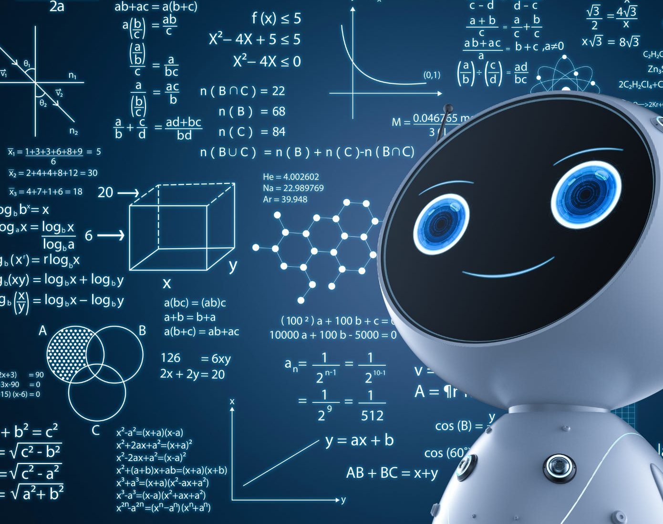
Happy Learning!

